Slide 1
Exam project
Group members: Ali, Szabolcs, Alex

Slide 2
The website (multiple pages)

Slide 3
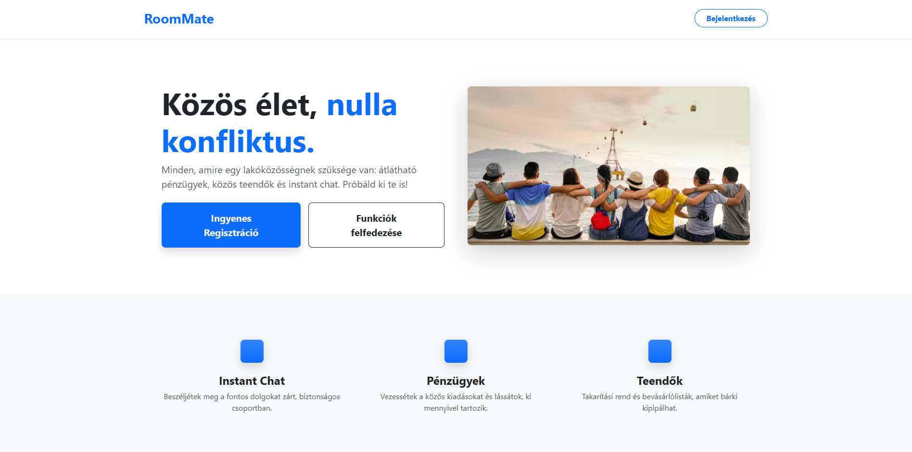
Main page

Slide 4
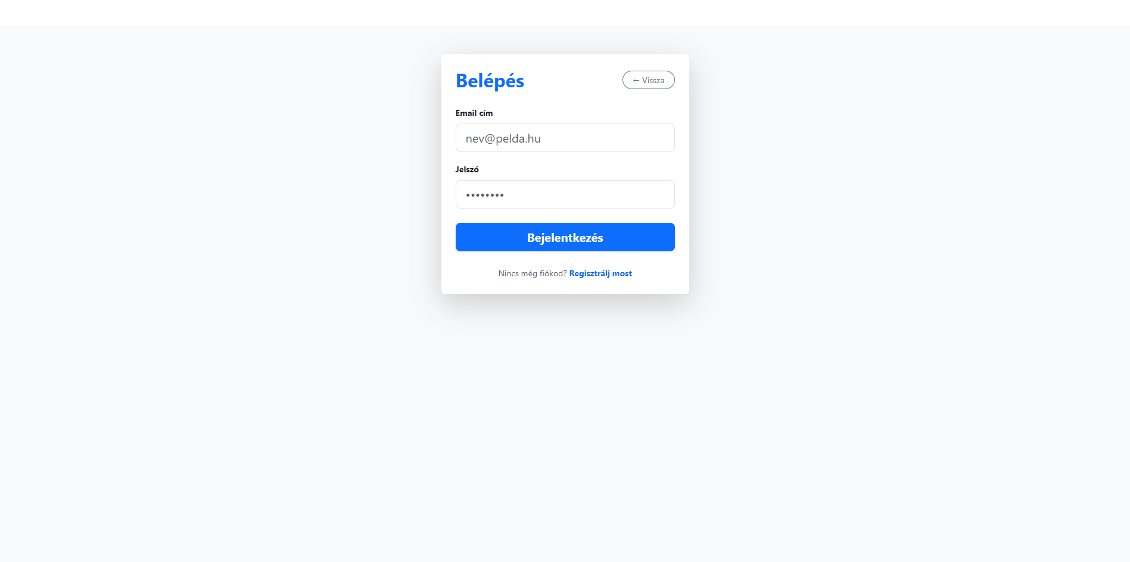
Login page

Slide 5
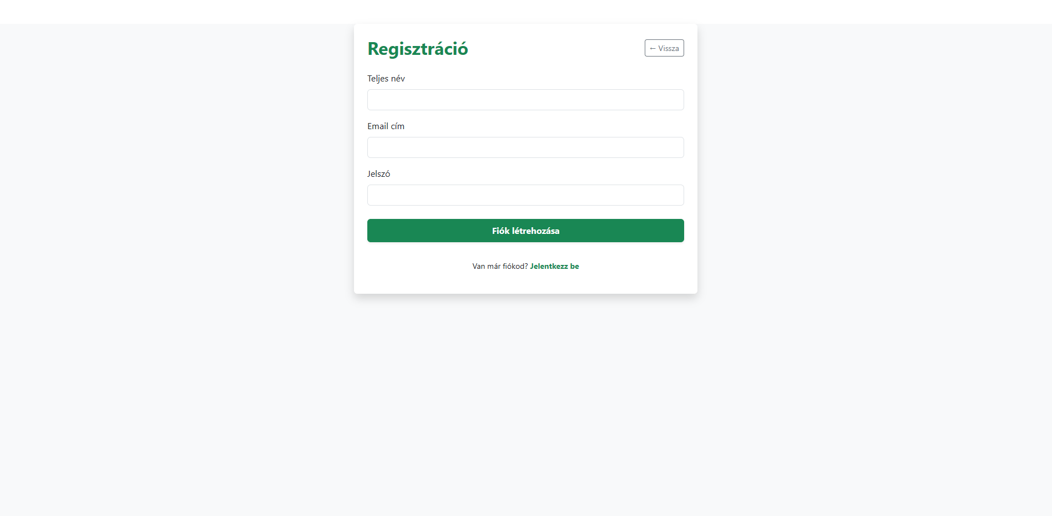
Register page

Slide 6
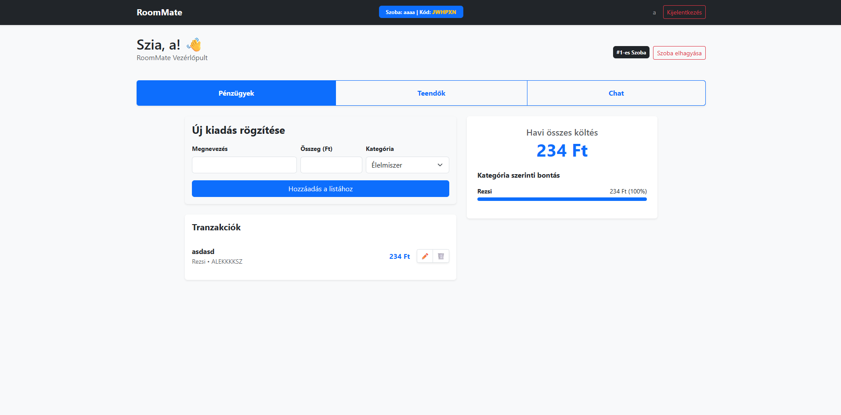
Budget page

Slide 7
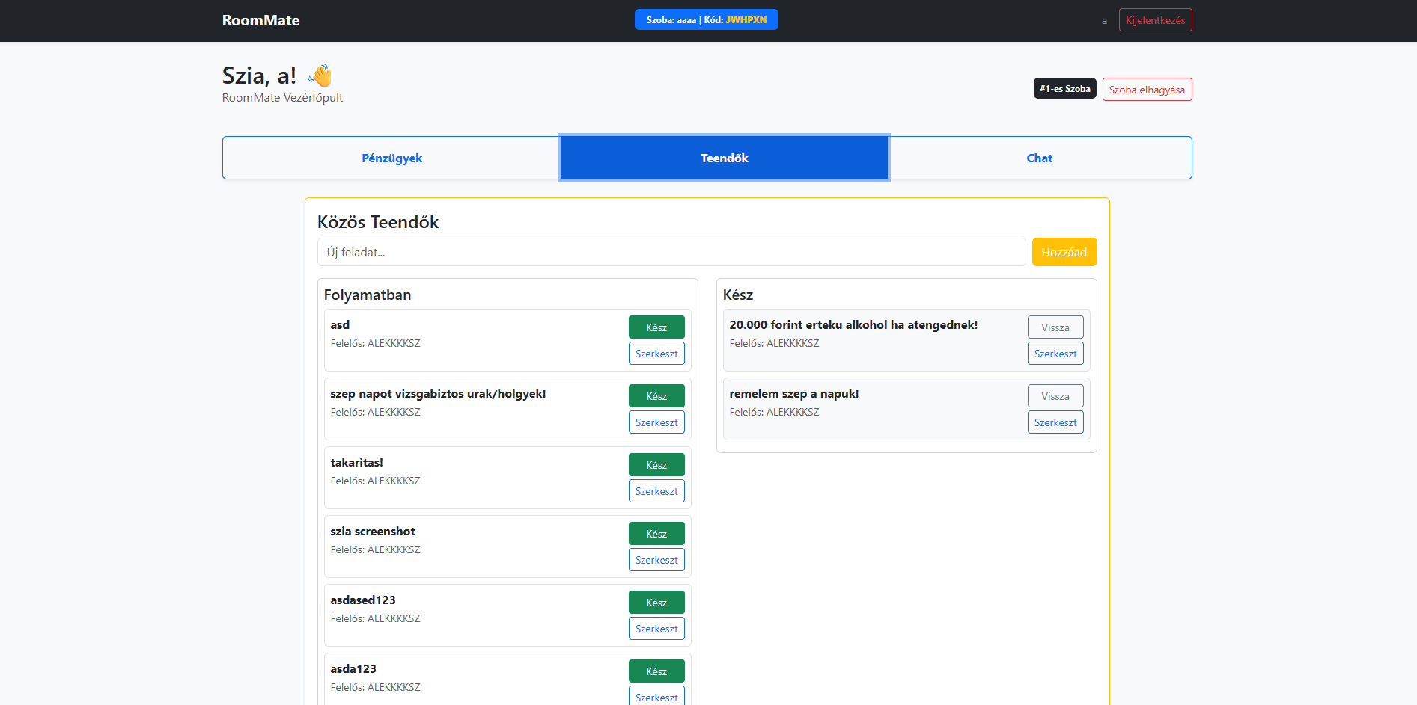
To-do page

Slide 8
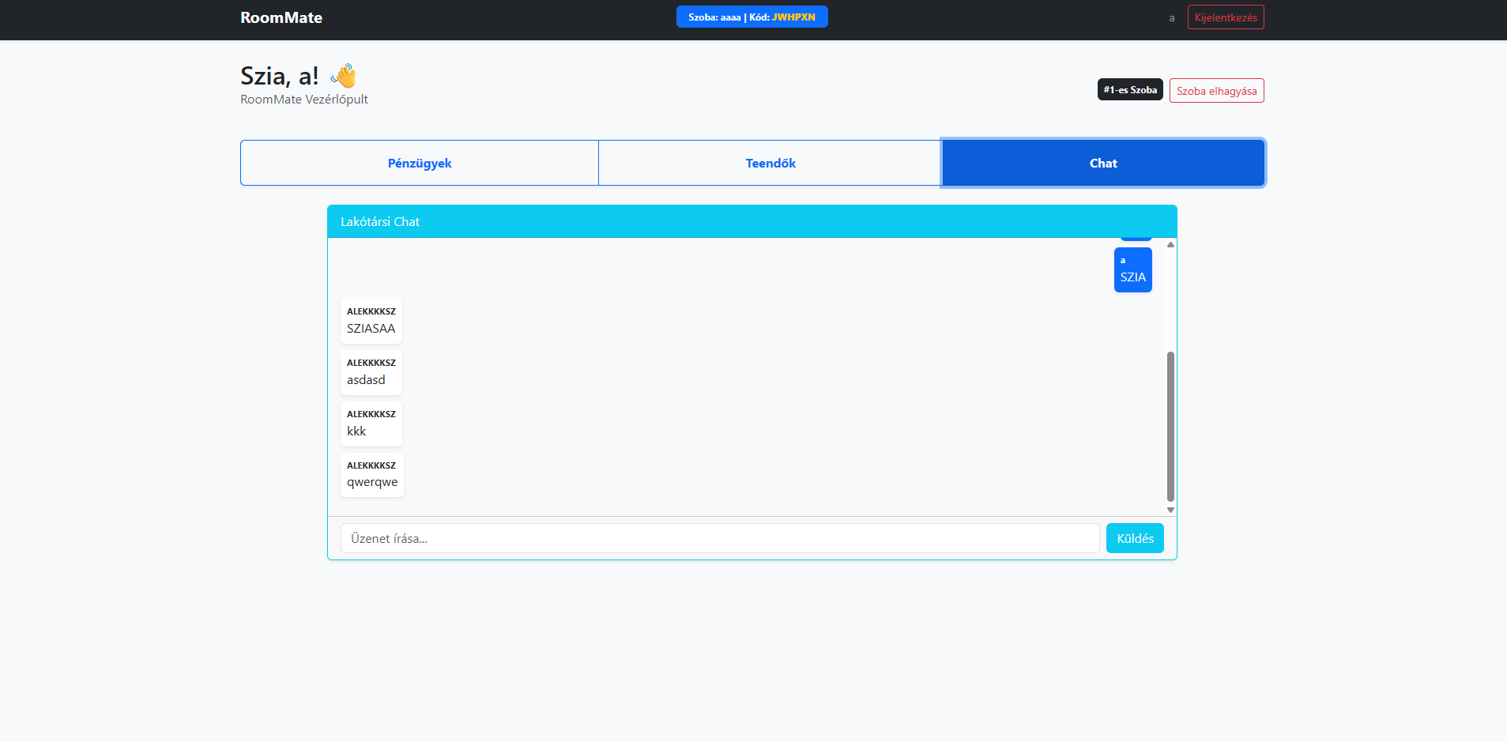
Chat page

Slide 9
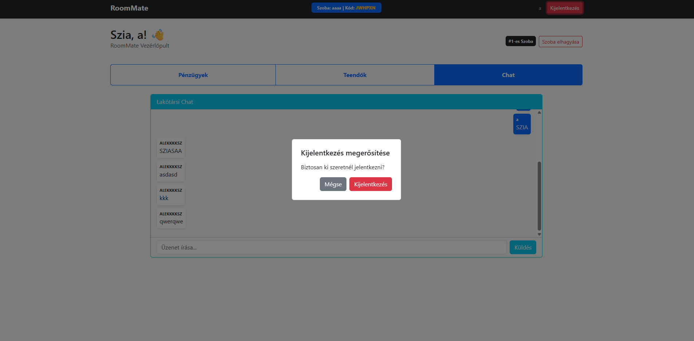
Lougout screen

Slide 10
Our code
Our code followed the principles of clean code
We unfortunately didnt include Laravel in our codebase
We took out the emojis after the screenshots due to it resembling AI generated conent

